Slide 1
Chinese Poetry Translation
Emma Huang, Juqy Chen
ECE 175B
Spring 2026
Prof. Xie

Slide 2
Problem
Motivation
We aim to solve the problem of efficient and high-quality English translations of classical Chinese poetry with small or medium sized models. The challenge is not only to preserve the poem’s literal meaning, but also to retain its cultural references, imagery, conciseness, and poetic style in English. Our project studies whether parameter-efficient fine tuning can make compact models competitive on this task.
This project is significant because it provides a scalable, low-compute framework for Chinese poetry translation. If successful, this methodology could be easily adapted to other low-resource or highly stylized translation tasks, such as translating ancient prose, religious texts, or indigenous storytelling.
Notes:
The problem
In the recent years, the rise of AI has led to highly sophisticated and intelligent Large Language models - LLMs capable of forming natural and human like language. LLMs have also shown an improvement over traditional machine translations as they are able to incorporate and understand contextual and relational information much better than traditional methods.~\cite{gao2024machine} However, LLMs have yet to master the translation of foreign language poems, which is far more difficult than academic or everyday language. As Robert Frost puts it, "Poetry is what gets lost in translation," which implies that poetry is some intangible, ineffable thing, which although constructed in language cannot be transposed across languages.
and motivation

Slide 3
Dataset
Sources: PoetMT (classical poem to English pairs) and CCPM (classical-poetry comprehension), merged into one corpus.
Preprocessing: kept only translation pairs, capped English length at 2000 characters, and removed duplicate / malformed rows.
Split (poems): 621 train / 68 validation / 78 test. Test and validation data only contains translations.
Leakage control: a fixed 78-poem canonical test set, shared by every model; verified that no test poem appears in training.
Notes:
Your core idea / method

Slide 4
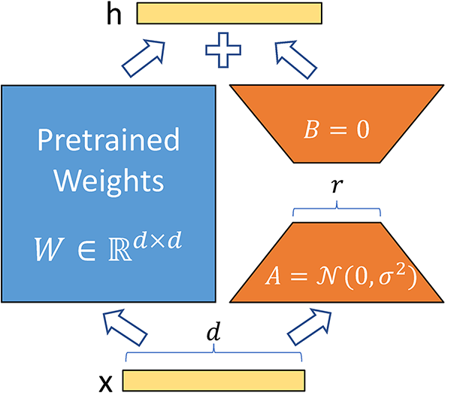
Method:
Qwen2.5-1.5B-Instruct (Decoder-Only): Our first method uses a lightweight decoder-only model. We utilize the Instruct variant more suitable for translation tasks. By applying QLoRA, we can perform stylistic fine-tuning of the literal translation to elegant English verse.
Qwen2.5-0.5B-Instruct (Decoder-Only): We utilized a smaller model of Qwen to test the capabilities of LoRA/QLoRA improve performance on small and light weight models.
mT5-base (Encoder-Decoder): Our second method applies QLoRA to mT5-base (580M), a massively multilingual encoder-decoder pre-trained via span-corruption. The encoder builds a dedicated representation of the classical Chinese source; the decoder cross-attends to it at each generation step, providing a structural translation inductive bias. QLoRA adapters target all three sublayer types: Self-Attention (q, k, v, o) to encode historical context and regulate English meter; Cross-Attention (q, k, v, o) to align the English decoder with the Chinese encoder; and Feed-Forward (wi0, wi1, wo) to specialize poetic vocabulary, updating fewer than 1% of parameters.
OPUS-MT-ZH-EN (Encoder-Decoder): A 74M Marian encoder-decoder pre-trained on large-scale Chinese-to-English parallel corpora. Unlike the multilingual generalists, Opus-MT is already competent at Chinese-to-English translation, reducing fine-tuning to domain adaptation: specializing a capable translator to the classical poetry register. We apply LoRA adapters (r=32, alpha=64) to the attention projections (q, k, v, o) and feed-forward layers in both encoder and decoder, updating fewer than 2% of parameters on a single consumer GPU.

Slide 5
Method: Opus-MT
Opus-MT-zh-en (Encoder-Decoder): A compact 74M Marian encoder-decoder pre-trained on large-scale Chinese-to-English parallel corpora. Unlike general-purpose multilingual models, Opus-MT is already competent at Chinese-to-English translation, reducing fine-tuning to a domain adaptation problem: specializing a capable translator to the classical poetry register. We apply LoRA adapters (r=32, alpha=64) to all attention projections (q, k, v, o) and feed-forward layers in both encoder and decoder, updating fewer than 2% of parameters. The model's task-aligned pretraining serves as an inductive prior, allowing LoRA to focus on register adaptation rather than learning the translation task from scratch, deployable on a single consumer GPU.

Slide 6
Results
Method / Base Model | BLEU4 | Brevity | ROUGE-L (F) | BERTScore (F) | Train Peak VRAM (GB) | Inf. Peak VRAM (GB)
Qwen0.5B-Instruct + LoRA | 1.6477 | 1.078 | 0.1788 | 0.8552 | 8.83 | 0.9
Qwen0.5B-Instruct + QLoRA | 2.0236 | 0.9098 | 0.1823 | 0.8599 | 7.43 | 0.9
Qwen0.5B-Instruct | 0.7455 | 2.3022 | 0.1326 | 0.8231 | N/A | 0.66
Qwen1.5B-Instruct + LoRA | 2.8991 | 1.007 | 0.2036 | 0.8621 | 12.73 | 1.91
Qwen1.5B-Instruct + QLoRA | 2.8582 | 1.0257 | 0.2151 | 0.8643 | 8.42 | 1.91
Qwen1.5B-Instruct | 1.7459 | 1.9129 | 0.1625 | 0.8403 | N/A | 1.55
Opus-mt-zh-en + LoRA | 1.4506 | 0.5528 | 0.172 | 0.848 | 7.23 | 0.51
Opus-mt-zh-en | 0.7911 | 0.5696 | 0.1593 | 0.8364 | N/A | 0.5
mt5-base + LoRA | 0.2035 | N/A | 0.0868 | 0.8074 | N/A | N/A
mt5-base | 0.0005 | N/A | 0.0043 | 0.7508 | N/A | N/A

Slide 7
Conclusion
PEFT (LoRA/QLoRA) consistently improves translation quality across all architectures, confirming parameter-efficient fine-tuning as a viable low-compute strategy for classical poetry domain adaptation.
Task-aligned pretraining outweighs scale: Opus-MT (74M, BERTScore 0.848) outperforms the 8x larger mT5-base generalist (BERTScore 0.751), demonstrating that translation-specific pretraining is more critical than parameter count for low-resource poetry MT.
Decoder-only Qwen models scale predictably under QLoRA: Qwen2.5-1.5B achieves BERTScore 0.864, and even the 0.5B variant (0.860) rivals the 74M specialist, suggesting instruction-tuning provides a strong inductive prior for translation.

Slide 8
Future Work
01
Dataset size and coverage. High-quality parallel Chinese-English poetry corpora remain scarce. PoetMT is small relative to general-domain MT datasets and is dominated by Tang shi-style poetry, which may cause fine-tuned models to overfit to that register and generalize poorly to Song ci or ther classical forms.
02
03
Model Size Consistency: The current comparison between Opus-MT-zh-en (74M) and Qwen2.5 (500M) conflates architectural choice with model scale, as the approximately 6.8x parameter disparity precludes a clean attribution of performance differences. Future work should establish a strictly scale-controlled comparison by either identifying a decoder-only baseline of equivalent parameter count, or applying domain-adaptive pretraining on a large Chinese-to-English parallel corpus prior to poetry-specific fine-tuning, thereby isolating the contribution of architecture from that of task-aligned pretraining.
Generalizability. Our framework is validated only on classical Chinese poetry. While we expect the methodology to transfer to other highly stylized translation tasks (ancient prose, religious texts, indigenous storytelling), this remains a hypothesis until empirically tested.

